Slide 1
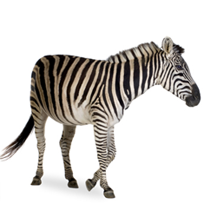
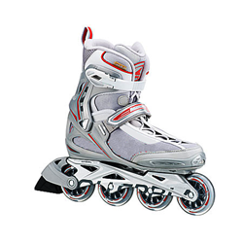
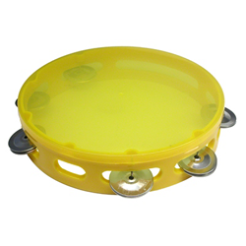
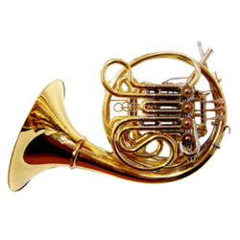
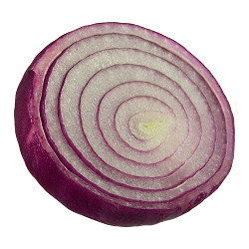
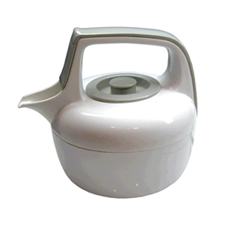
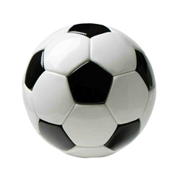
Classification analyses of the CIMA-Q fMRI memory task
Marie St-Laurent, PhD
September 20th, 2019

Slide 2
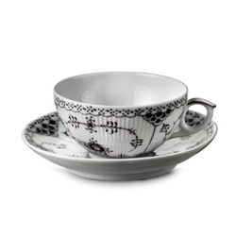
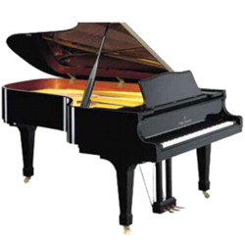
CIMA-Q: demographic data
Cohort (march 2019 release), n = 94
From 103 with all data available (dicom and eprime), 94 passed the preprocessing QC
Per diagnosis group:
24 Cognitively normal
49 Subjective Cognitive Decline (SCD)
21 Mild Cognitive Impairment (MCI)

Slide 3
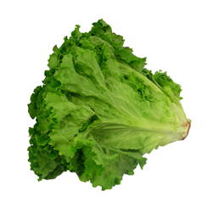
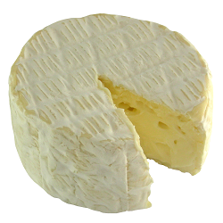
Descriptives: PCA on neuropsych scores
Data from 103 participants (including those who failed QC)
35 test scores from battery of neuropsych test
Scores normalized (z-scores), missing values replaced by mean
PCA with varimax rotation
12 Factors with eigenvalues > 1

Slide 4
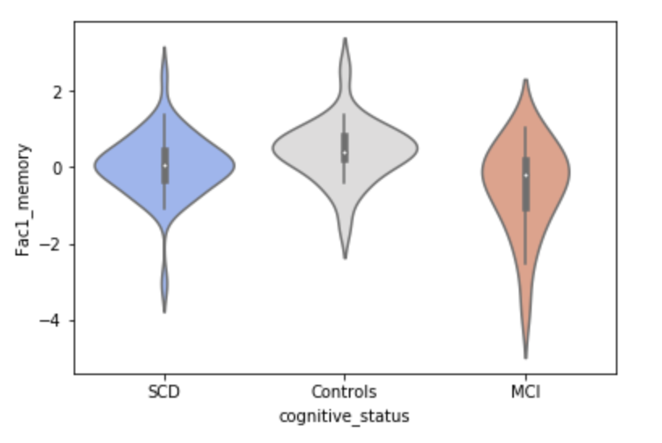
Latent factor 1: “memory”

Slide 5
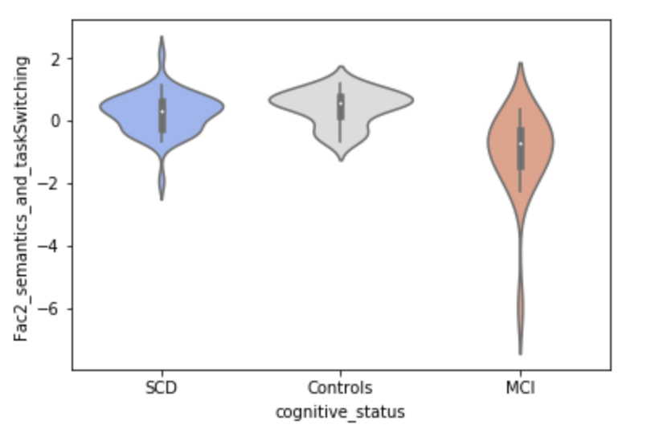
Latent factor 2: “semantic & task switching”

Slide 6
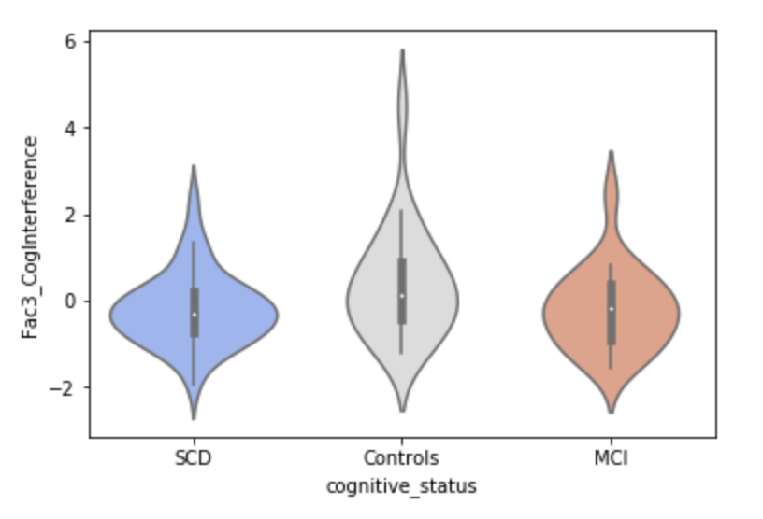
Latent factor 3: “cognitive interference”

Slide 7
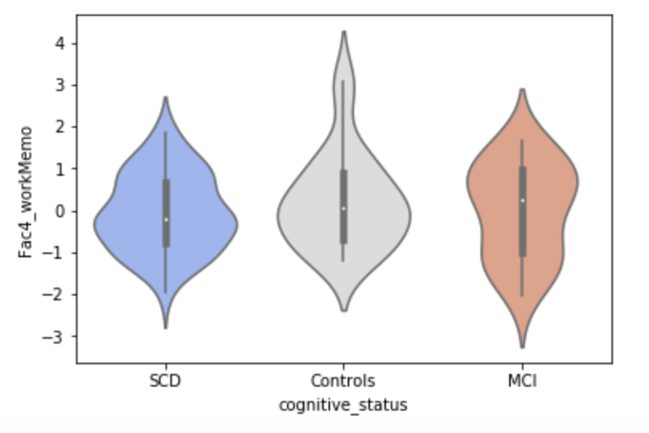
Latent factor 4: “working memory”

Slide 8
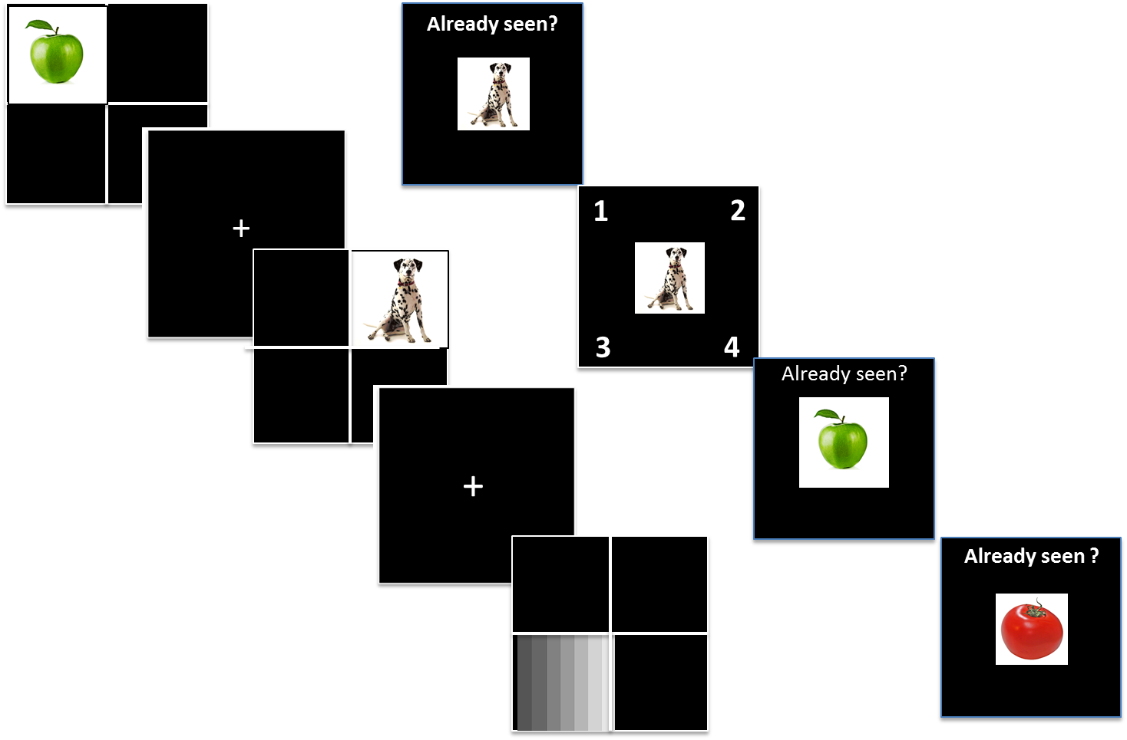
fMRI task paradigm
Encoding
Retrieval
In Scan:
78 “Encoding” trials: object image
39 “Control” trials: grey image
Image positioned in 1 of 4 quadrants
Button press
Post-Scan:
Image recognition:
Old or new?
If old, which quadrant?
Figure from M. Caillaud, June 2019

Slide 9
fMRI task paradigm
Encoding
Retrieval
In scan trials categorization
Condition: encoding or control (grey) task
Hit or miss: recognized as seen in scanner post-scan?
Correct or wrong source: was the recognized image positioned in the correct quadrant or not?
Figure from M. Caillaud, June 2019

Slide 10
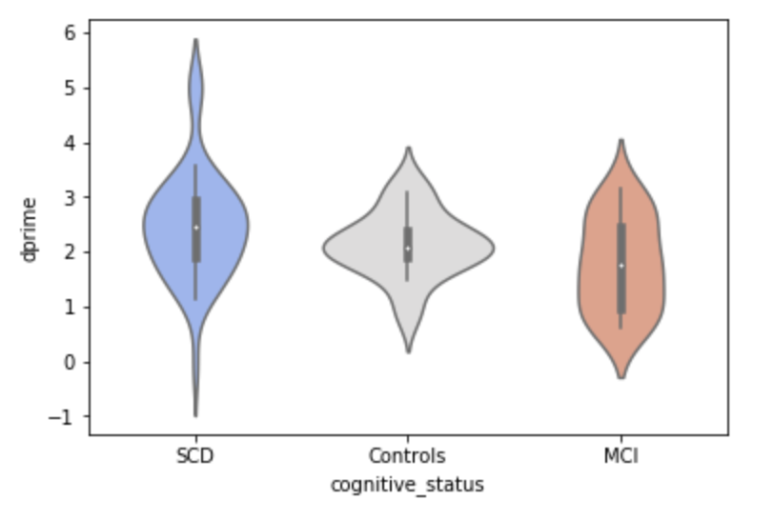
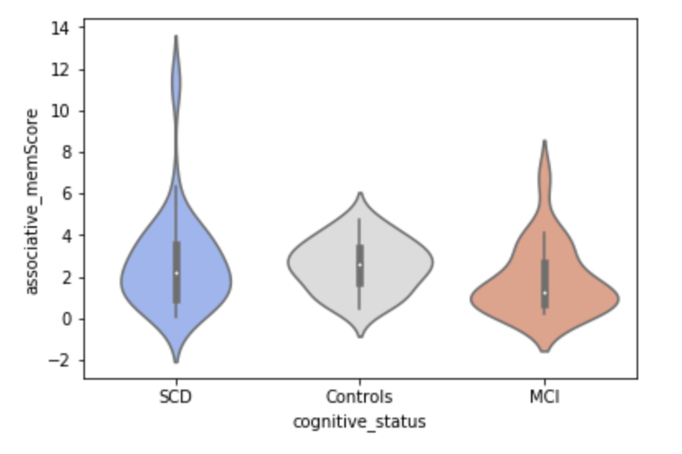
fMRI task performance per group
Note: dprime = infinity (perfect score) replaced by 5 for 3 participants)
Dprime:
z_prob (hits/old) – z_prob (false alarm/new)
Associative memory score :
Correct source / (wrong source + false alarm)

Slide 11
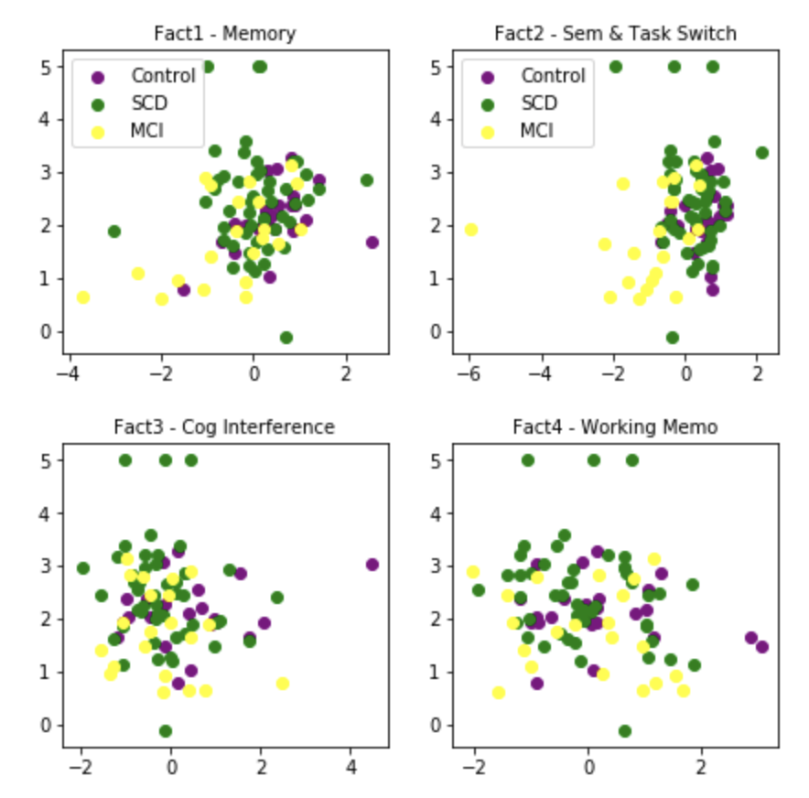
Neuropsych latent scores and fMRI task performance : dprime
r = 0.249*
The memory metrics reflect memory capacity!
MCI subjects (yellow) are worse than SCD (green) or controls (purple)
r = 0.159
r = -0.081
r = -0.191

Slide 12
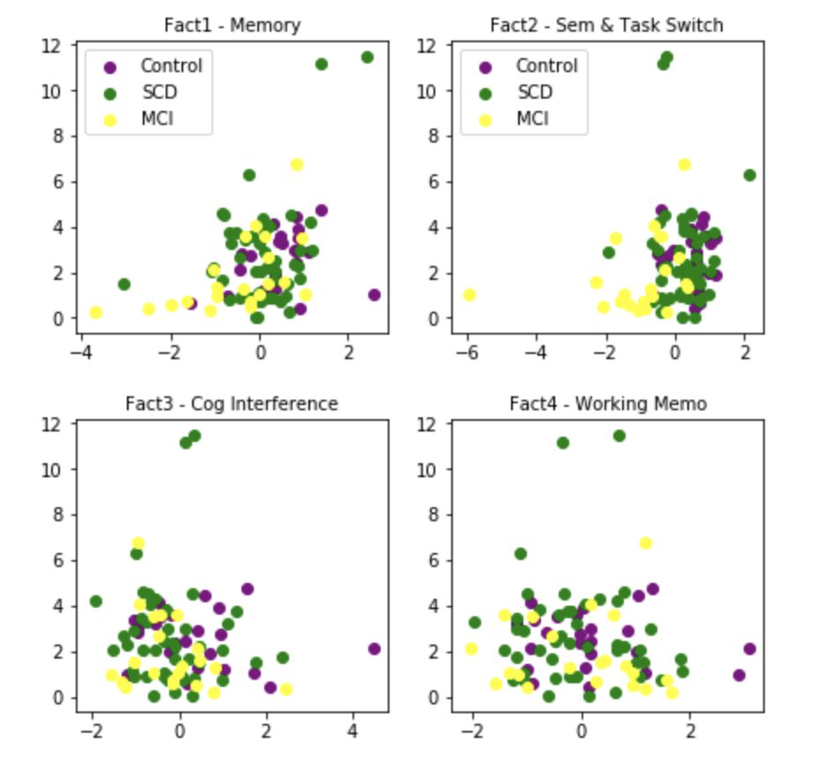
Neuropsych and fMRI task performance: associative memory score
The memory metrics reflect memory capacity!
MCI subjects (yellow) are worse than SCD (green) or controls (purple)
r = 0.396*
r = 0.151
r = -0.110
r = -0.075

Slide 13
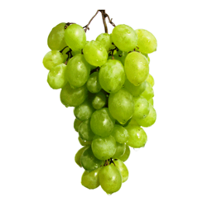
Classification of fMRI trials
Task Condition:
Image encoding vs Control task (grey rectangle)
“Hit” trials vs “Miss” trials
Images subsequently remembered vs forgotten post-scan
“Correct” vs “Incorrect” source (position) trials
Successfully recognized images (post-scan) positioned in the correct vs incorrect screen quadrant
“Correct source” vs “Miss” trials:
A stronger contrast between images remembered in context vs forgotten

Slide 14
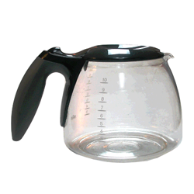
Features: brain maps of beta values
Beta maps per trial:
For each subject, one beta value per voxel, per trial.
A separate first-level model of the HDR is computed for each trial (spm model, Nistats).
The trial of interest is modelled as its own separate condition; other trials are split into two conditions of no interest (the image encoding and control tasks).
Network weights: MIST parcellation
For each trial:
beta values are averaged between voxels from the same ROI or network
Parcellations: 7, 20, 64, 325 and 444 networks

Slide 15
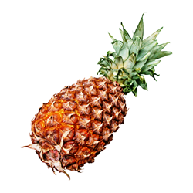
Classification: Task Conditions
i.e., “Is the participant seeing an object (encoding task), or just a grey square (control task)?”
Between-subjects analysis: trials pooled across subjects
From 103 subjects with complete data, 94 passed preprocessing QC
21 Controls, 21 MCI, 49 SCD
Subjects split (60/40) into a training (n = 56) and a test (n = 38) set
Training set : 6526 trials (4343 encoding, 2183 control task)
Test set : 4420 trials (2941 encoding, 1479 control task)
Stratified proportion of MCI, SCD and Control participants across sets

Slide 16
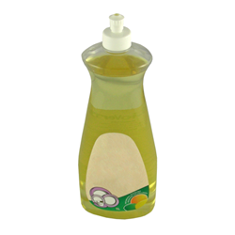
Classification: Task Conditions
Within-subject analysis: model trained and tested on subsets of trials from the same person
78 encoding & 39 control trials per subject
Trials split (60/40) into sets stratified per task condition
training set : 47 encoding & 23 control trials
test set: 31 encoding & 16 control trials
Classification scores averaged across the 94 subjects who passed QC
Model: support vector classifier (LinearSVC in Nilearn)
Balanced class weights (to compensate for unmatched number of events per category)
10-fold cross-validation on training set
Max iteration increased to 10,000 (10x default), but failed to converge for between-subject analysis…

Slide 17

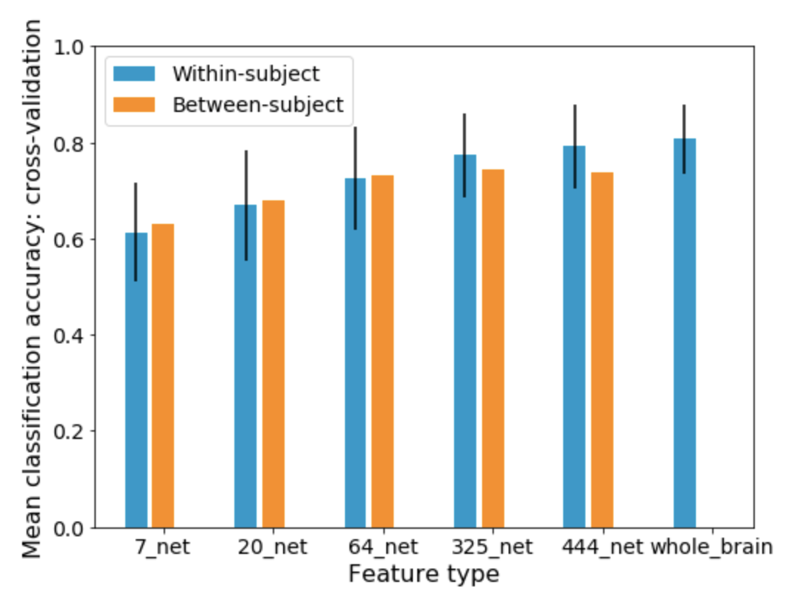
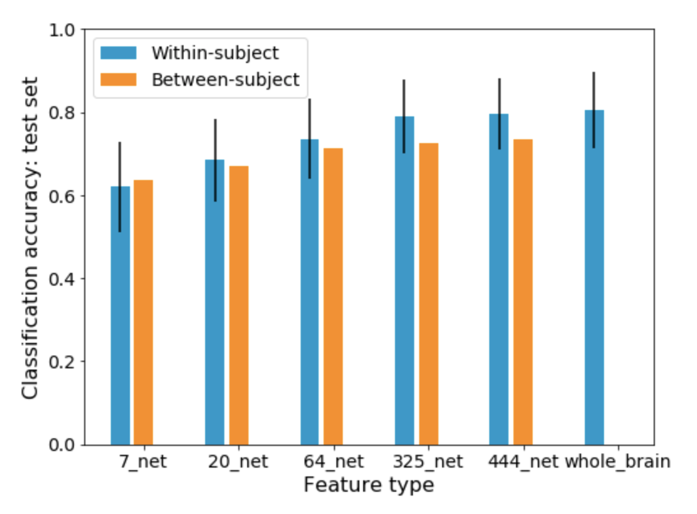
Classification: Task Conditions

Slide 18
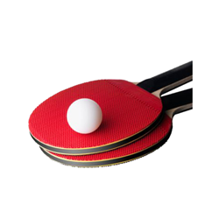
Classification: Task Conditions
Between-subject classification: Feature coefficients (20-network parcel.)
Bottom line: I found the visual cortex!

Slide 19
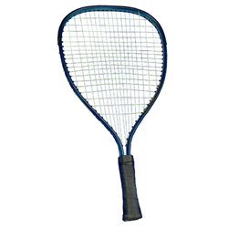
Classification: Hit vs. Miss trials
i.e., “Was the image recognized as ‘old’ during the post-scan test (hit), or mistaken for a ‘new’ unseen image (miss)?”
Between-subjects analysis: trials pooled across subjects
42 participants from 94 who passed QC:
at least 15 hit and 15 miss trials
10 Controls, 11 MCI, 21 SCD (stratified per set)
Subjects split (60/40) into a training (n = 25) and a test (n = 17) set
Training set : 1928 trials (1266 hit, 662 miss)
Test set : 1319 trials (850 hit, 469 miss)

Slide 20
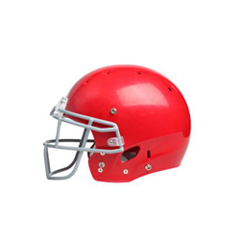
Classification: Hit vs. Miss trials
Within-subject: model trained and tested on subset of trials from the same subject
29-63 hit trials & 15-49 missed trials per subject
Trials split (60/40) into sets stratified per task condition
Scores averaged across the 42 subjects with enough hit/miss trials
Model: support vector classifier (LinearSVC in Nilearn)
Balanced class weights (to compensate for unmatched number of events per category)
Cross-validation on training set: 10-fold (between-sub) and 7-fold (within-sub)
Failed to converge for between-subject analysis…

Slide 21
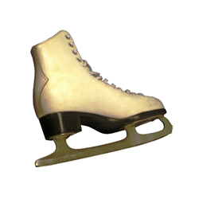
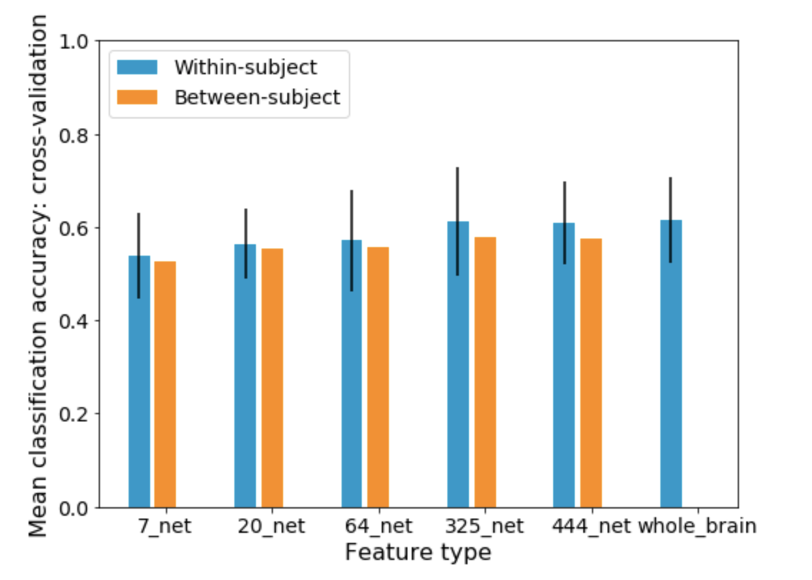
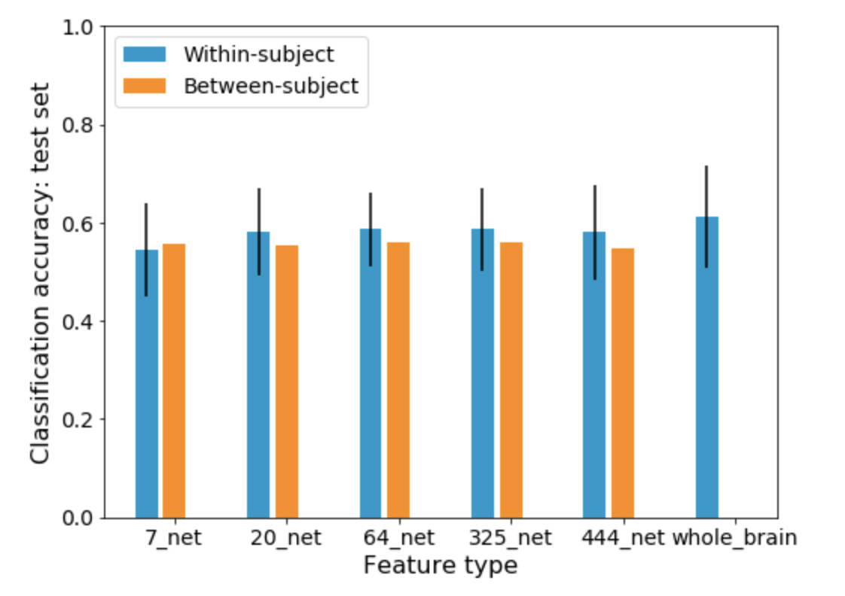
Classification: Hit vs. Miss trials

Slide 22
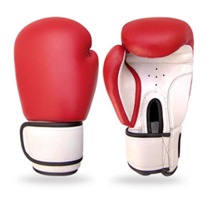
Classification: Correct vs. Incorrect Source
i.e., “Was the image recognized as ‘old’ positioned in the correct quadrant (source) during the post-scan test?”
Between-subjects analysis: trials pooled across subjects
49 participants from 94 who passed QC:
at least 15 correct and 15 incorrect source trials
10 Controls, 26 SCD, 13 MCI (stratified per set)
Subjects split (60/40) into a training (n = 29) and a test (n = 20) set
Training set : 1889 trials (1136 correct source, 753 wrong source)
Test set : 1149 trials (722 correct source, 427 wrong source)

Slide 23
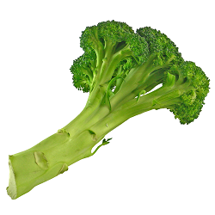
Classification: Correct vs. Incorrect Source
Within-subject: model trained and tested on subset of trials from the same subject
15-61 correct source trials & 15-44 wrong source trials per subject
Trials split (60/40) into sets stratified per task condition
Scores averaged across the 49 subjects with enough trials
Model: support vector classifier (LinearSVC in Nilearn)
Balanced class weights (to compensate for unmatched number of events per category)
Cross-validation on training set: 10-fold (between-sub) and 7-fold (within-sub)
Failed to converge for between-subject analysis…

Slide 24
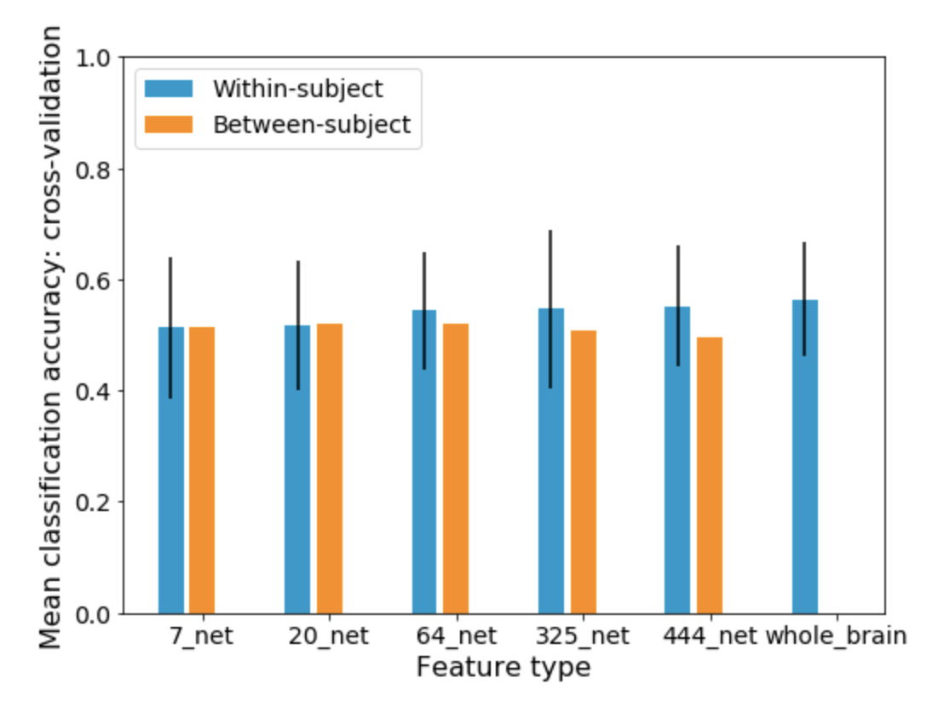
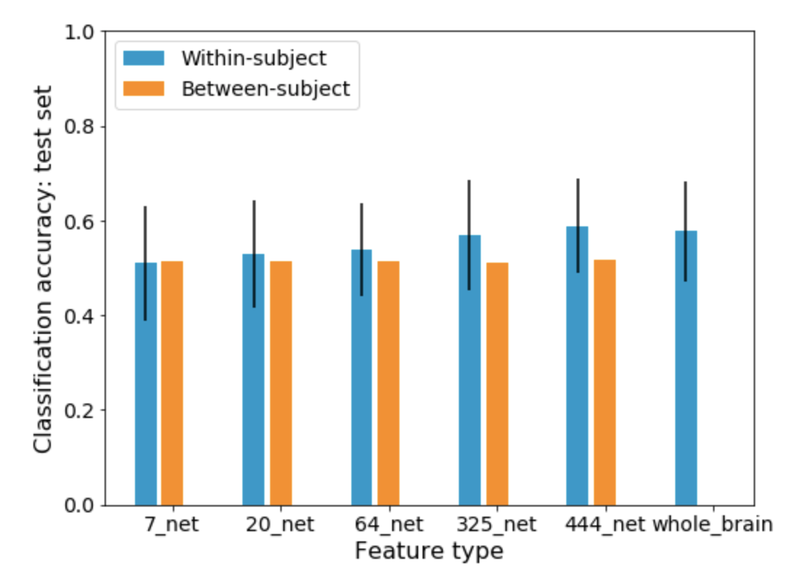
Classification: Correct vs. Incorrect Source

Slide 25
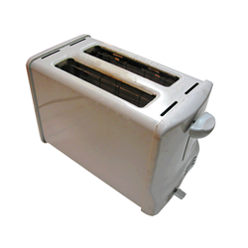
Classification: Correct Source vs. Miss trials
i.e., “Was the image recognized as ‘old’ AND positioned in the correct quadrant (source), or was it mistaken for a new image during the post-scan test?”
Between-subjects analysis: trials pooled across subjects
38 participants from 94 who passed QC:
at least 15 correct source and 15 miss trials
9 Controls, 19 SCD, 10 MCI (stratified per set)
Subjects split (60/40) into a training (n = 22) and a test (n = 16) set
Training set : 1270 trials (703 correct source, 567 miss)
Test set : 980 trials (570 correct source, 410 miss)

Slide 26
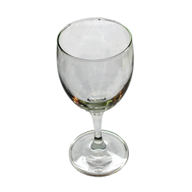
Classification: Correct Source vs. Miss trials
Within-subject: model trained and tested on subset of trials from the same subject
15-56 correct source trials & 15-44 miss trials per subject
Trials split (60/40) into sets stratified per task condition
Scores averaged across the 38 subjects with enough trials
Model: support vector classifier (LinearSVC in Nilearn)
Balanced class weights (to compensate for unmatched number of events per category)
Cross-validation on training set: 10-fold (between-sub) and 7-fold (within-sub)
Failed to converge for between-subject analysis…

Slide 27
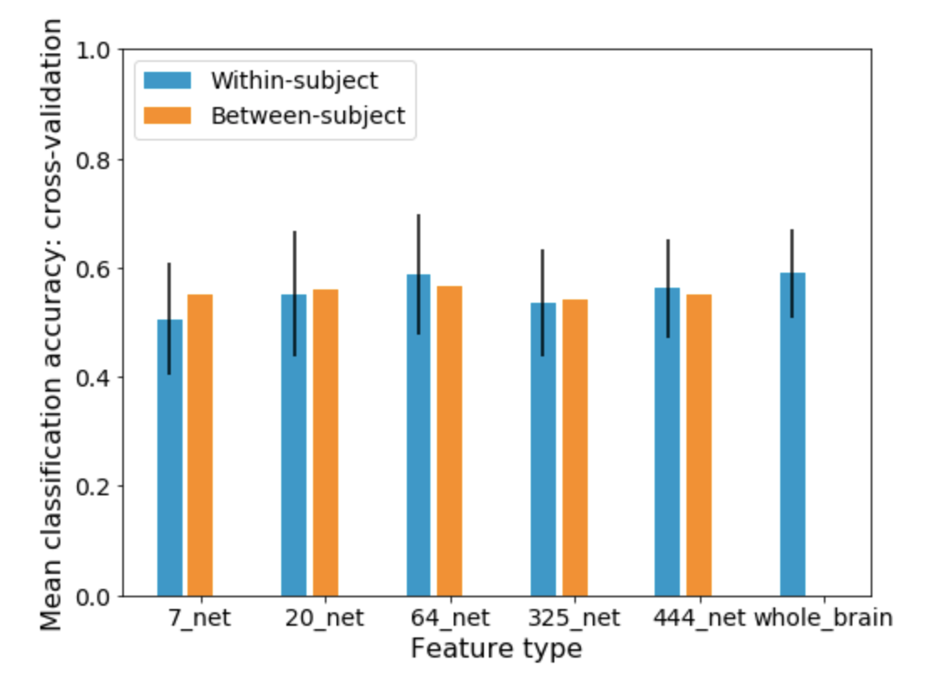
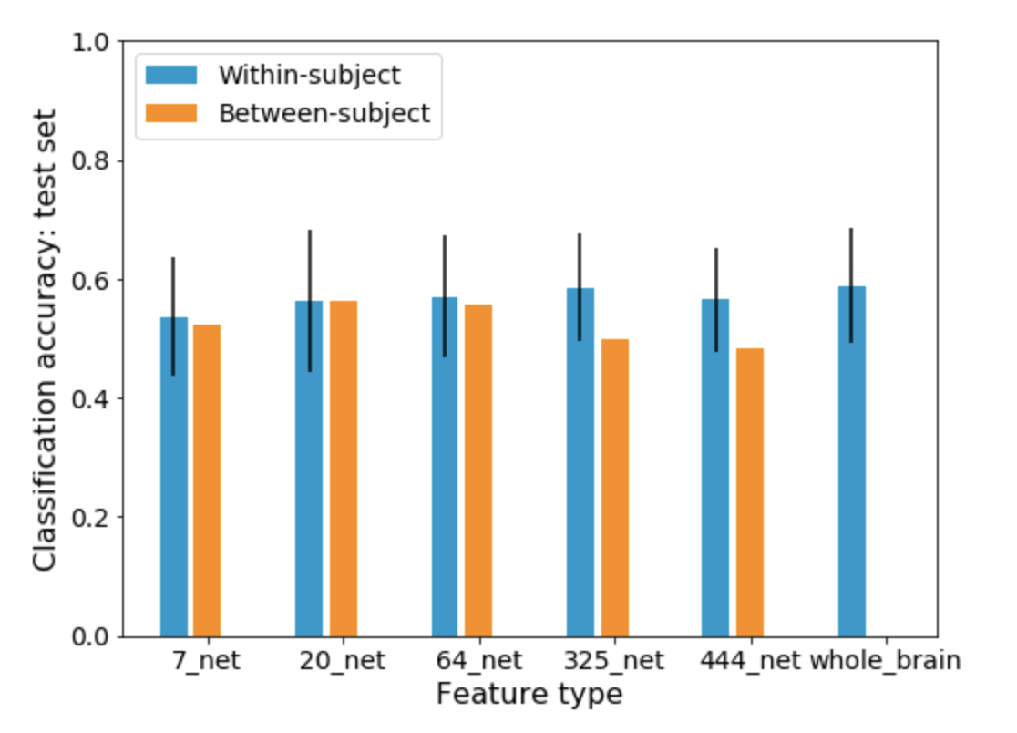
Classification: Correct Source vs. Miss trials

Slide 28
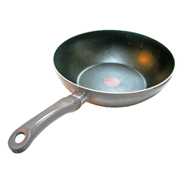
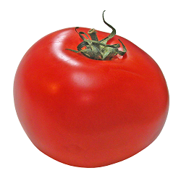
Factors influencing within-subject classification?
Motion
Number of “scrubbed” frames
Mean frame displacement
Task performance
Dprime : z_prob (hits/old) – z_prob (false alarm/new)
Asso memo score : Correct source / (wrong source + false alarm)
Imbalance between trials per categories
Asb (Hit – Miss)
Abs (Correct – Wrong)
Abs (Correct – Miss)

Slide 29
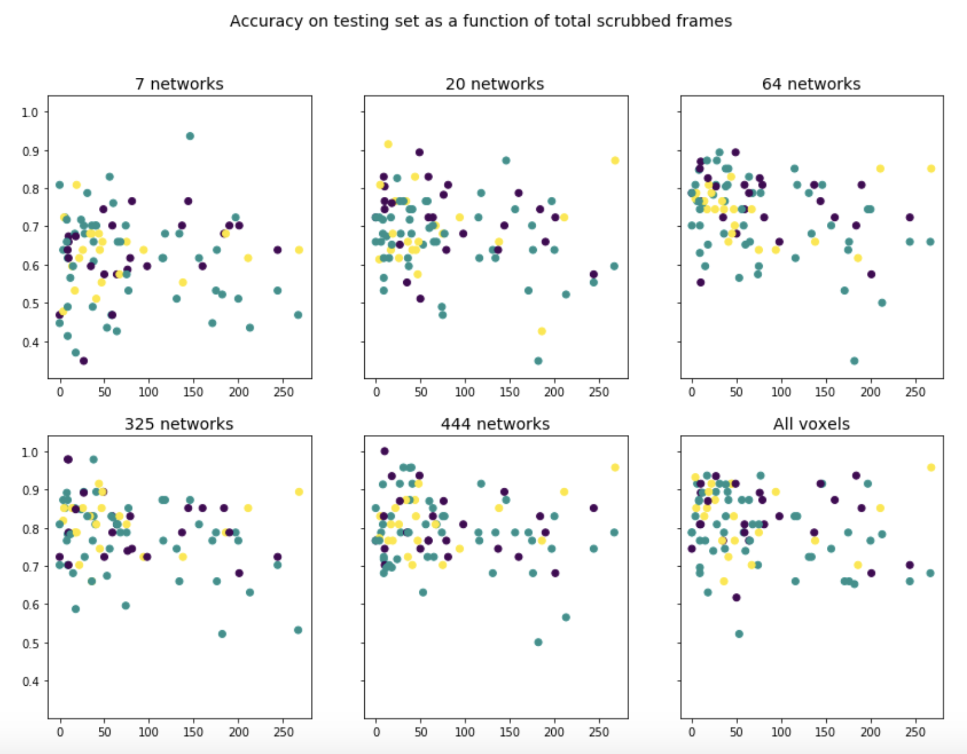
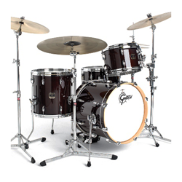
Task Condition: Motion (scrubbed frames)
r = - .036
r = - .191
r = - .306
r = - .276
r = - .122
r = - .202

Slide 30
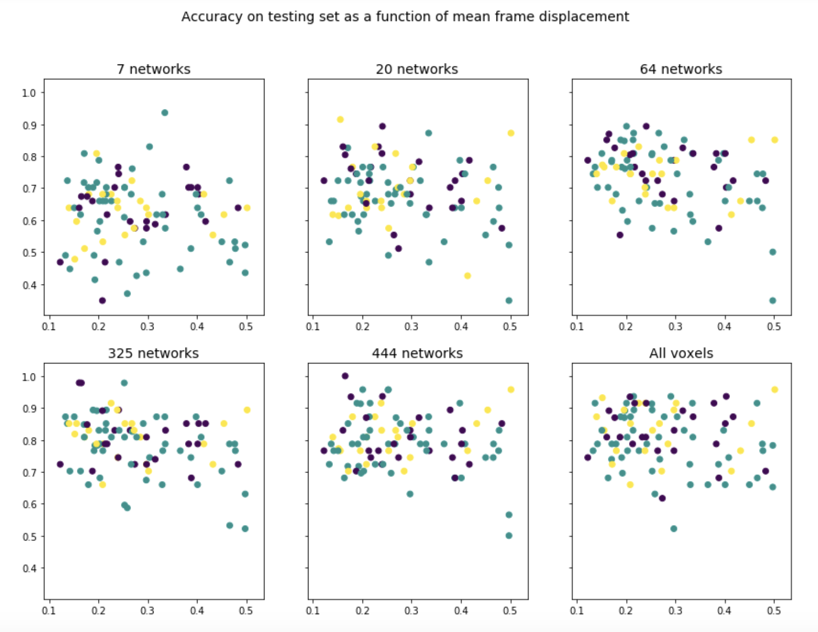
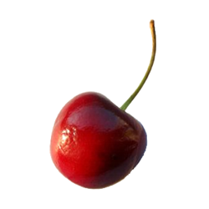
Task Condition: Motion (mean frame displ.)
r = - .065
r = - .205
r = - . 322
r = - .298
r = - .130
r = - .171

Slide 31
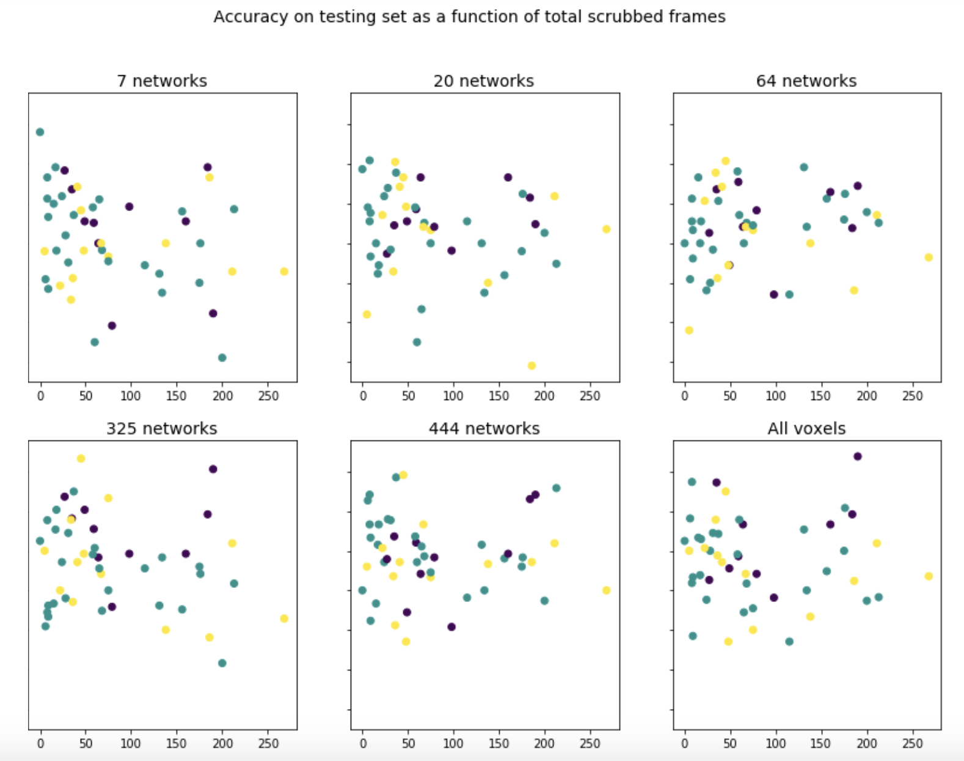
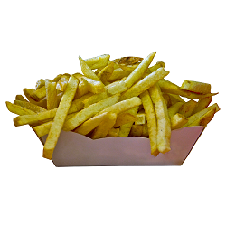
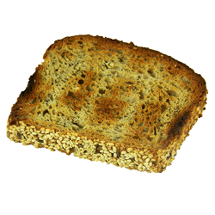
Although not as consistent for other analyses (e.g., correct vs incorrect source classification)
r = - . 248
r = - . 159
r = . 101
r = - .205
r = - .007
r = - .037

Slide 32
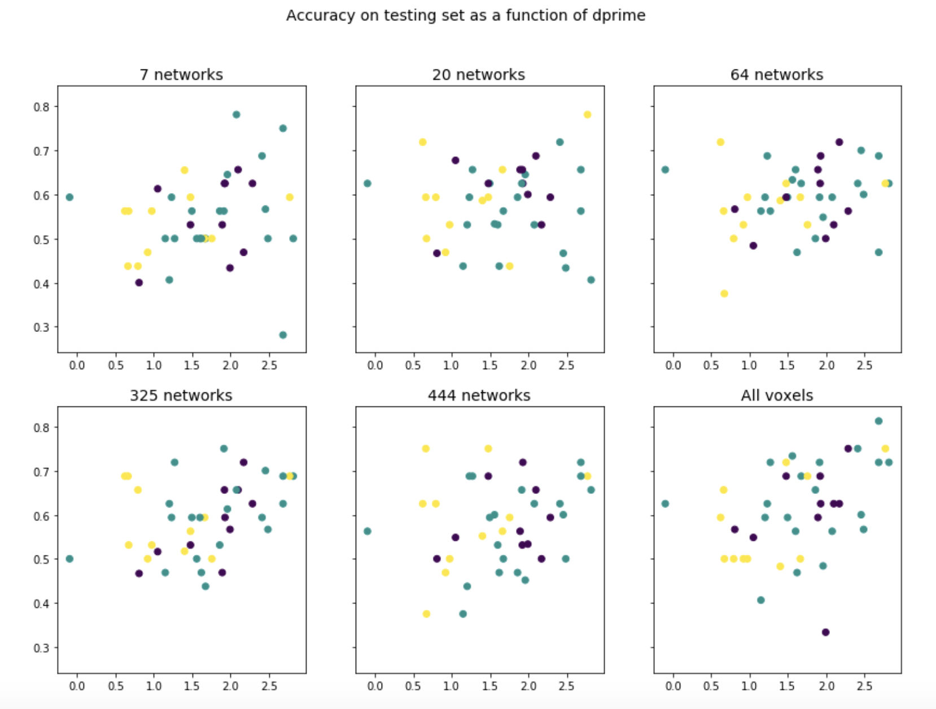
Hit vs Miss : dprime (0 = guessing)
Re-do between-sub hit-miss classification (444 networks)
Keep subjects w < 100 scrubbed frames
Dprime > 1.0 (n = 24)
Mean CV (train) acc = .621
Test set acc = .533
Controls only (n = 8)
Mean CV (train) acc = .597
Test set acc = .547

Slide 33

Correct vs Incorrect source : associative memory score
r = - . 085
r = - . 005
r = . 298
Re-do between-sub cs-ws classification (444 networks)
Controls only (n = 10)
Mean CV (train) acc = .625
Test set acc = .539
Asso memScore > 1 (n = 26)
Mean CV (train) acc = .546
Test set acc = .534
r = .241
r = .254
r = .475

Slide 34

Correct vs Incorrect source : unbalanced classes
r = . 081
r = .115
r = . 440
Absolute difference in number of trials per class: abs(#corr_so - #incorr_so)
Some subjects appear to have above-chance classification, but it’s most likely driven by unbalanced number of trials per class…
r = .429
r = .431
r = .609

Slide 35


Hit vs Miss trials : unbalanced classes
Even worse here…
Classification as function of Abs (#hit – #miss)
r = - .025
r = .161
r = . 441
r = .559
r = .619
r = .752

Slide 36



What else can I classify?...

Slide 37

Predicting latent memory score (neuropsych) from fMRI task contrast
i.e., “are there brain activity patterns observed during the fMRI task that are indicative of good general memory?” (e.g., good memory brain signature?)
Beta maps per condition(s):
For each subject, one map of beta values per contrast:
encoding vs control trials (n = 94, 56/38)
hit vs. miss trials (> 9 trials per condition, n = 61, 36/25)
correct vs. incorrect source trials (> 9 trials per condition, n = 83, 49/34)
correct vs. miss trials (> 9 trials per condition, n = 59, 35/24)
Model: Support Vector Regression (Nilearn)
predict subject’s general memory based on fMRI data
One event (vectorized brain contrast) per subject
10-fold cross-validation on training set
??Failed to converge for between-subject analysis…

Slide 38
Predicting latent memory score (neuropsych) from fMRI task contrast
Results: R^2
R^2 = (1 - u/v),
where u = residual sum of squares ((y_true - y_pred) ** 2).sum()
v is the total sum of squares ((y_true - y_true.mean()) ** 2).sum()
Note: a negative values indicates a model arbitrarily worst than chance...

Slide 40

Thank you, Neuromod!
With special thanks to
Pierre Bellec
Julie Boyle
Claude Godbout
Arnaud Boré
Hanad Sharmarke
Pravish Sainath
Pierre-Emmanuel Morin
Marie Caillaud
Yu Zhang
Desiree Lussier-Levesque ($\left|é\right| ∈ [0−3]$)

